Slide 1
Transformative Justice
Education and Outreach Committees

Slide 2
Transformative Justice
“Transformative justice (TJ) is a political framework [that asks] how do we respond to harm without creating more harm? How do we respond to violence, harm and abuse without relying on state systems—the police, the criminal legal system, immigration and customs enforcement, prisons, the foster care system? And also, at the same time, [we want to] actively cultivate the things that we know prevent violence, things like safety, accountability, healing, justice, connection and transparency.” - from Mia Mingus
sexual violence is not a case of a few bad apples; exists at EPIDEMIC RATES
“What we know from our work is that when you publicly shame someone, when you do character assassination, 9 times out of 10 it doesn’t stop the violence, it doesn’t transform the behavior. It just means that they go underground and they figure out how to hide the violence better. I wish it was more transformative. I wish we were engaging in deeper conversations about justice.” - Mia Mingus
the importance of working with perpetrators is emphasized-- “No one comes out of the womb knowing how to torture somebody, how to rape somebody, or sexually assault somebody. These are learned behaviors.”

Slide 3
TJ (cont.)
True accountability as changing your behavior so that the harm does not happen again (not only apologies, and repairing trust)
“A common structure for a TJ process is you have a survivor and three or four people supporting them. Then you have the person who caused harm and three or four people supporting them in their accountability. That’s what we strive for, and we call it pods.
Then there is a coordinator or facilitator, or a circle of coordinators/facilitators.
Then you’ll have the survivor think of what their demands are. What would it look like for person who caused harm to be accountable to you? That could include everything from a year of feminist therapy to disclosure to any people they’re dating for the next three years about what they’ve done. It can look like needing to write letters of apology, it could look like outing themselves at work.
We’re trying to create human processes for human people.” - Mia Mingus

Slide 4
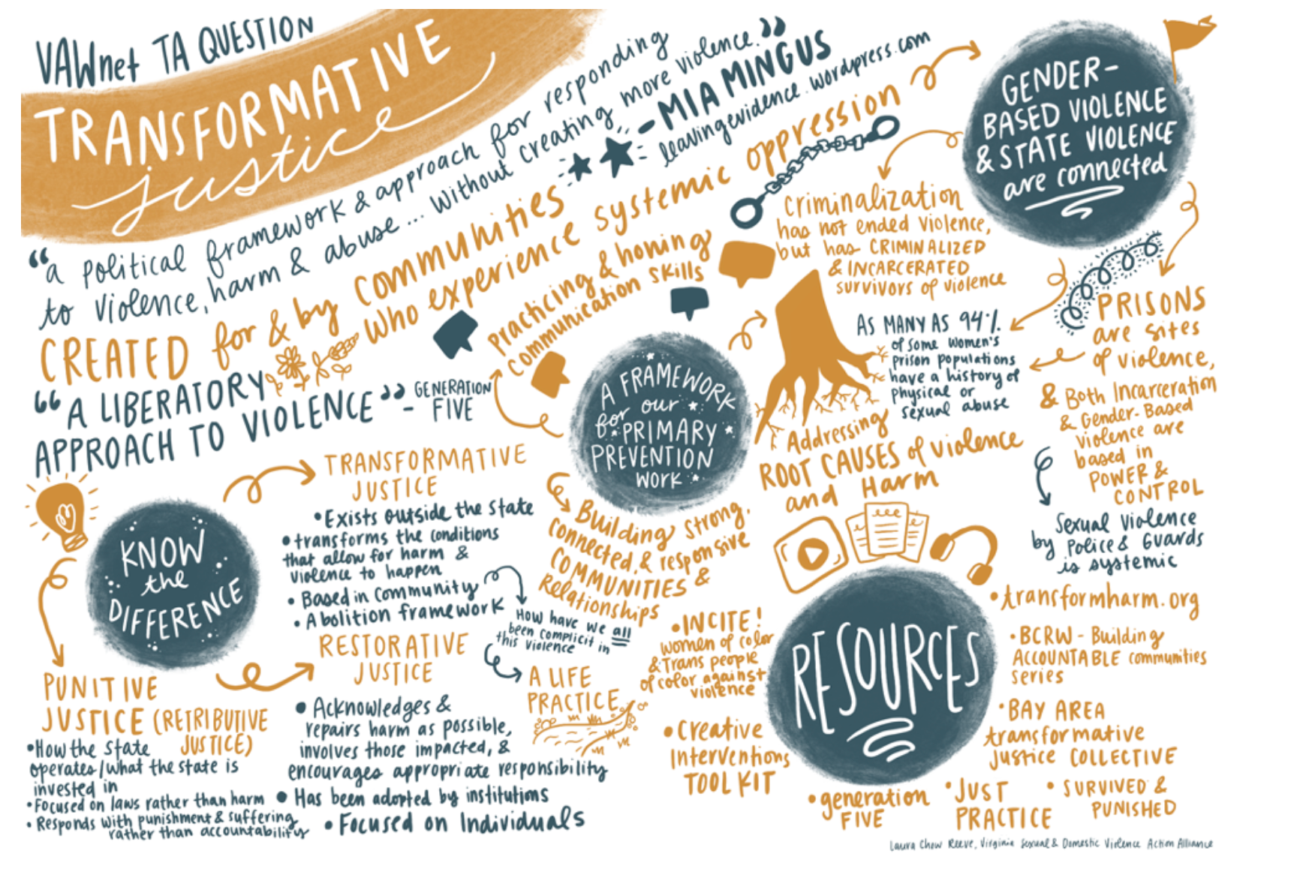

Slide 5
How Defense Attorneys vs. Prosecutors think about Justice
Defense perspective: “police the police,” checks/balances on the criminal justice system.
“It is somewhat odd to be doing (almost) God’s work, yet to have so few people acknowledge the vital import of the work.”
Prosecutor perspective: upholding justice/the system, ensuring safety and order in society.
Review charges, determine offenses, offer plea bargains, makes sentencing recs, advises investigative process for police (NAP)
https://www.nacdl.org/Article/June2012-TheRoleofDefenseCounselinEnsur
“The Role of Defense Counsel in Ensuring a Fair Justice System”

Slide 6
Thinking about violent vs nonviolent inmates--how the system is treating or not treating them differently
A lot easier to justify having violent offenders in jail
https://www.prisonpolicy.org/reports/violence.html
Article on why states should be including violent crime offenders within evergrowing justice reform.
Take violence more seriously & invest in prevention tactics rather than just lengthy jail/prison sentences >> relics from the “tough on crime” era
[Most] Current state reforms are focused solely on the “non, non, nons”
Excluding these categories offers less of a solution >> the reforms affect such a small population of people
Louisiana (excluded violent offenders) vs. Mississippi (included violent offenders) reforms
Article ends with numerous recommendations
Supervise more people convicted of violent offenses in the community instead of putting them in prison
Invest in evidence-based rehabilitative programs in prisons
Invest in robust re-entry services
Invest in violence-prevention programs
https://allianceforsafetyandjustice.org/crimesurvivorsspeak/
Crime Survivors Speak >> looking at what violent crime victims want in terms of justice//rehabilitation.
New Safety Priorities
Shorter Sentences, Smarter Investments
Alternatives to Incarceration
Reducing Incarceration to put more support in Rehabilitation & Prevention

Slide 7
The persuasive argument for change?
What is the impetus to actually change this system, to make it happen? How are we reaching perpetrators who don’t see this as a problem?
Convicted offenders more likely to reoffend
For victims who do report, experience with the criminal justice system may lead to secondary victimization
Conviction rates are low
Unfounded rates are twice as high for sexual assault cases as they are for non-sexual physical assault, reinforcing the low confidence victims have in the police and criminal justice system
Rather than rehabilitate offenders, prisons can have the opposite effect (Sered 2017). It is well documented that prisons can serve as criminal training grounds, and that people of colour are disproportionately charged, convicted, and kept in prison compared to white criminals

Slide 8
Thinking about Breonna Taylor and what happened today? What does justice look like? Specifically, what does it look like for black womxn?
Officers who do harm aren't usually arrested by the depts that employ them
Is the current system able to hold them accountable?
This requires the system to hold itself accountable, but it regularly fails to
What can accountability look like outside of this system?
https://www.essence.com/feature/breonna-taylor-justice-abolition/

Slide 9
Breonna Taylor and Transformative justice
https://www.vice.com/en/article/9353ky/what-is-transformative-justice-police-abolition
Using the system that enables police to be violent to discipline the police, only propagate the violence
Community accountability
Relies on community members to choose the type of justice they would like
Not outsourcing to cops
Ex. INCITE!
Restorative justice
Survivor has a sense of agency
Want to hear a public apology
Transformative justice
Supporting a survivor’s healing
Confrontation to the abuser
Community members account for their own complicity
Police use one size fits all model
Force and law results
Fire them instead
Promise they can’t work in law enforcement again
Sit down with people they harmed?
What does transformative justice look like in the context of police brutality?

Slide 10
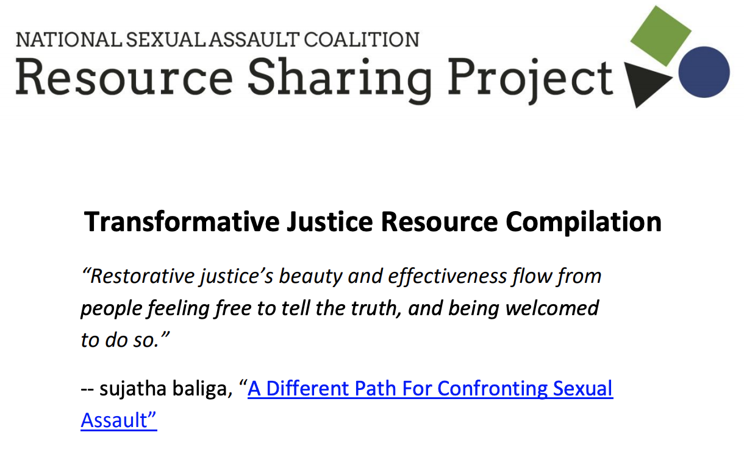
Any resources for transformative justice
https://www.creative-interventions.org/tools/toolkit/
Creative interventions: “Current activities focus on building capacity for grassroots social justice organizations and supporting domestic violence and sexual assault organizations to make community-based, transformative justice and community accountability interventions a real option”
Notes:
http://www.resourcesharingproject.org/sites/resourcesharingproject.org/files/RSP_2019_Compilation_of_Transformative_Justice_Resources.pdf

Slide 11
Any resources for transformative justice
A PDF describing the relationship between victims of child abuse and crime, then the application of transformative justice.
http://www.generationfive.org/wp-content/uploads/2013/07/G5_Toward_Transformative_Justice-Document.pdf
A curriculum guide for transformative justice made by Project NIA. It is primarily short readings accompanied by discussion questions.
https://niastories.files.wordpress.com/2013/08/tjcurriculum_design_small-finalrev.pdf
Documentary on Public Defenders: Gideon’s Army. Just Mercy is also great to read/watch on the racial problems within the justice system and how Death Row works against marginalized communities.
Notes:
http://www.generationfive.org/wp-content/uploads/2013/07/G5_Toward_Transformative_Justice-Document.pdf
https://niastories.files.wordpress.com/2013/08/tjcurriculum_design_small-finalrev.pdf

Slide 12
Interesting Article By Teen Vogue
https://www.teenvogue.com/story/transformative-justice-explained
Very helpful to understand what transformative justice is, and how it is in effect in real situation (context and examples given)

Slide 13
Summary of Videos
Video #1
Anti violence movements struggled with the question with what do we do with people who do harm?
Criminal legal system crushing our communities
People are hungry for other mechanisms for how do you reasonably help that person not be responsible for that harm without putting them into a situation that crushes them
Accountability?
Taking responsibility for your choices and the consequences of those choices
There is no batterer’s island
When you kick somebody who has assaulted someone out of your communities, they go to the next community and do harm
Does not mean that we have to take Individual responsibility for the harm being done, but as communities we need to be thinking of solutions
Reasonable and appropriate consequences for harm doers?
Self accountability and accountability on a community level
What are accountable communities?
Creating environments where it is possible to be accountable
Current consequences: go to jail, be ostracized, want to crush / isolate you
Those are the fears that people who have harmed are dealing with
Very difficult to publicly claim accountable
“We cannot end domestic violence and sexual assault without learning how to support people who do harm in practicing accountability”

Slide 14
Video #2
Self accountability?
Are the choices that I am making aligning with my values?
Each of us building skills around self-accountability as a key step towards building accountable communities
So used to accountability being “I’m going to get that person that wronged me.” Accountability as being something that happens to them
Seek help. It is really hard to see the answers when you are inside the situation.
Very difficult work
The work of practicing self-accountability is turning back to it over and over again.
Doing your best approximation of who you want to be.

