Slide 1
A Reflection on ASAP this Semester
Reviewing what we learned and discussing our thoughts/reflections

Slide 2
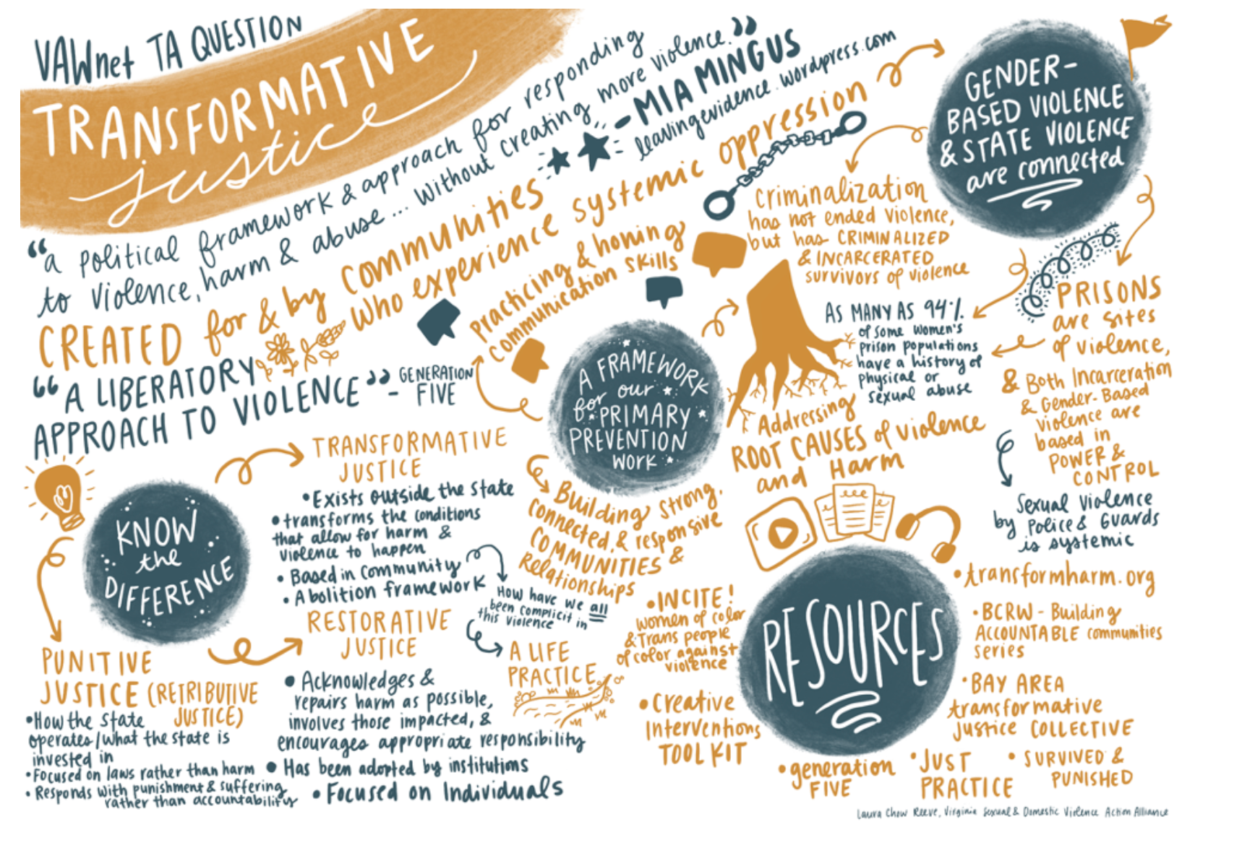
Transformative Justice

Slide 3
Thinking about Oluwatoyin Salau and Megan Thee Stallion
3 main controlling images that prevent black women from reporting sexual violence--Jezebel/Black Promiscuity, Black Superwoman, Cultural Protector
The role of social media in propagating narratives surrounding sexual assault
How we treat victims and perpetrators of violence? How do we make social media more conducive to a less punitive, more transformative mindset?
Hashtag activism and what that means for a movement
Black women as the most unprotected members of our society
Superficial protection being tackled with the rise of mutual aid funds

Slide 4
Questions for Reflection
What are accountable communities and how do we create them?
Are we able to create accountable communities on social media? If not, how do we go about doing so?
Is there a place in society for rehabilitation of perceived criminal behavior? If so, where?
What behaviors/actions can be considered forgivable and how can we make these judgements on a broad scale?
How well does the current criminal justice system prioritize the safety of and justice for the victims?
How might we retain or improve this prioritization for the victims in a reformed or transformed criminal justice system?

Slide 5
Moving Forward
How can we continue to protect and center the voices of survivors at Penn in this upcoming semester?
Events that you want to plan, or things you would like to do differently?

