Slide 1
Thinking about Oluwatoyin Salau and Megan Thee Stallion
Black Womxn in the Context of BLM

Slide 2
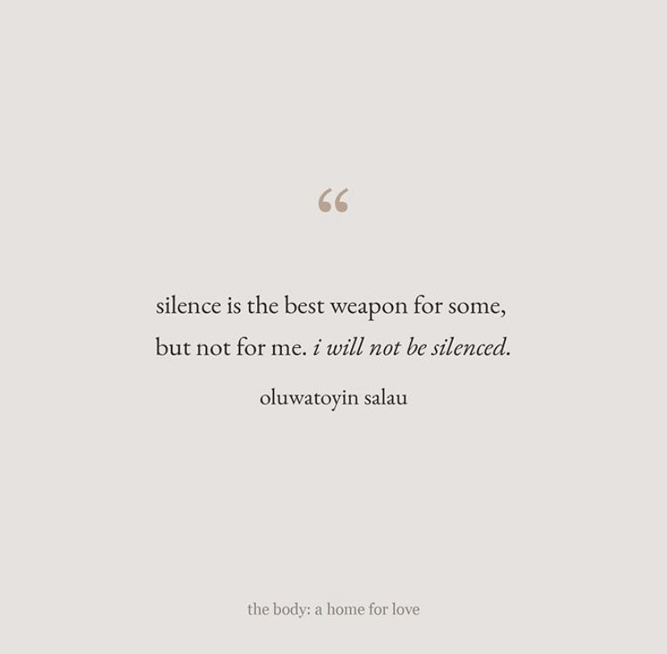
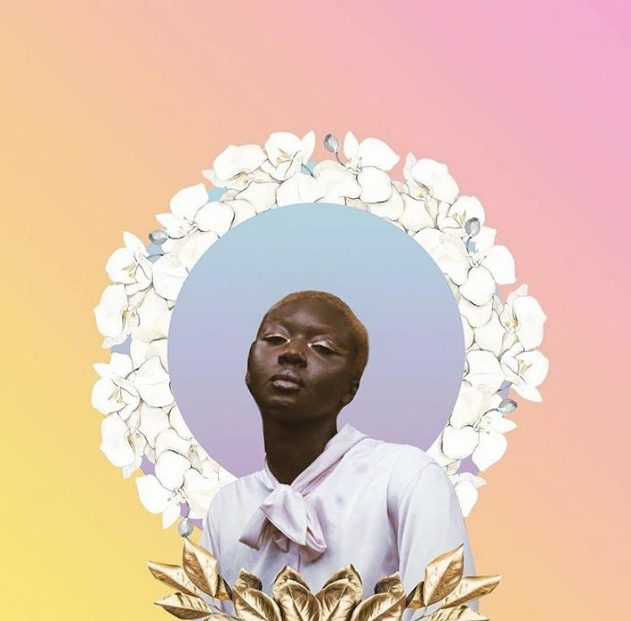
Oluwatoyin “Toyin” Salau
Toyin was an activist who disappeared on June 6, 2020, after tweeting about two instances of being sexually assaulted
Her body was found on June 14, 2020, with that of Victoria Sims, a 75-year-old who had also been active in local politics
Aaron Glee Jr. later confessed to kidnapping and killing them both
Toyin’s murder inspired the trending of “RIP Toyin,” “Toyin,” and #JusticeForToyin

Slide 3
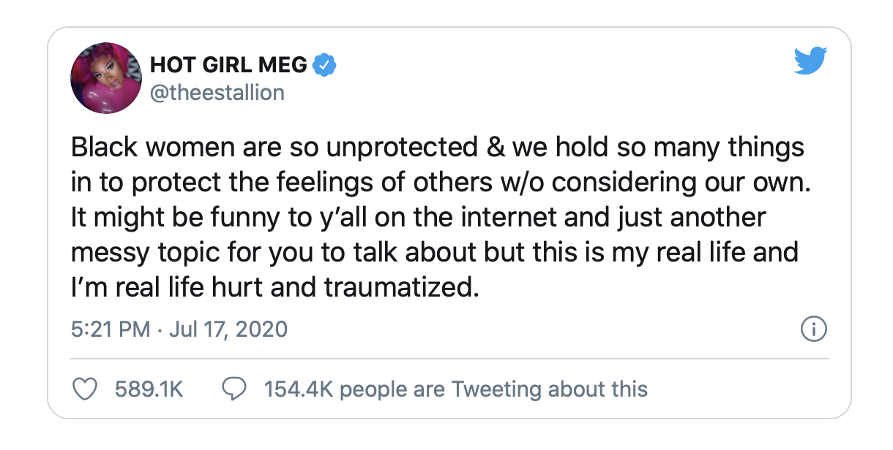
Megan Thee Stallion
After an argument involving Megan Thee Stallion and Tory Lanez in a van, Megan tried to leave. Tory Lanez fired at her as she was attempting to leave.
She was shot in both feet, had to have surgery to have the bullets removed.
After the incident, Lanez was arrested at 4:40 a.m. July 12 and charged with a felony, according to information from the Los Angeles Sheriff Department. He is currently out on bond after posting a $35,000 bail.
LA DA office is considering whether to pursue charges
At first, both parties were not cooperative with the police--Megan was afraid that it would end in more bloodshed

Slide 4
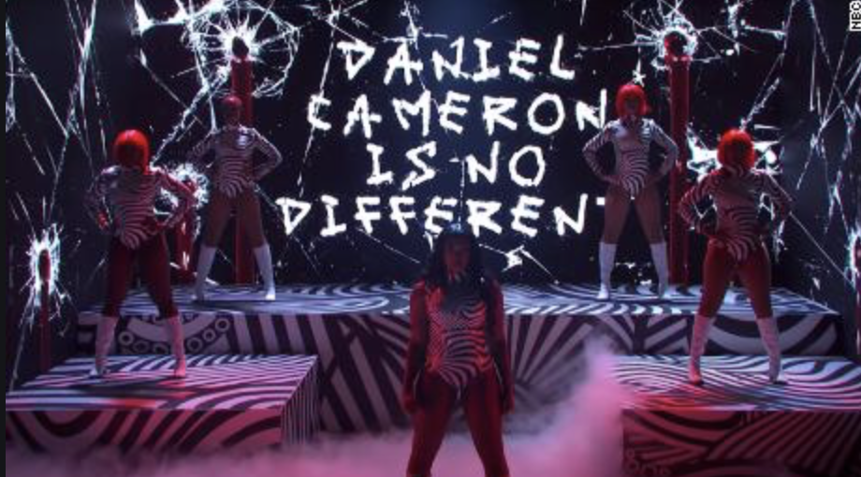
Megan Thee Stallion at SNL

Slide 5
“Rape and Racial Appraisals: Culture, Intersectionality, and Black Women's Accounts of Sexual Assault”by C. Shawn McGuffey
“The racial appraisal perspective asserts that race and culture are outside victims and are used by individuals to construct personal interpretations of a tragic event” (McGuffey 110)
There are 3 main “controlling images” used to prevent Black women from reporting their cases of sexual violence (McGuffey 112)
The Jezebel/Black Promiscuity: “social actors justify the systematic targeting of Black women for sexual violence and exploitation by characterizing women of African descent as always sexually willing” (McGuffey 112)
The Black Superwoman: Black women “stereotyped as emotionally impervious, independent, and highly resilient to the worst that life has to offer, including sexual assault” (McGuffey 112)
The Cultural Protector: Black women needing to remain silent about the harm done to them by Black men, because society already has enough negative stereotypes of Black men (McGuffey 112)

Slide 6
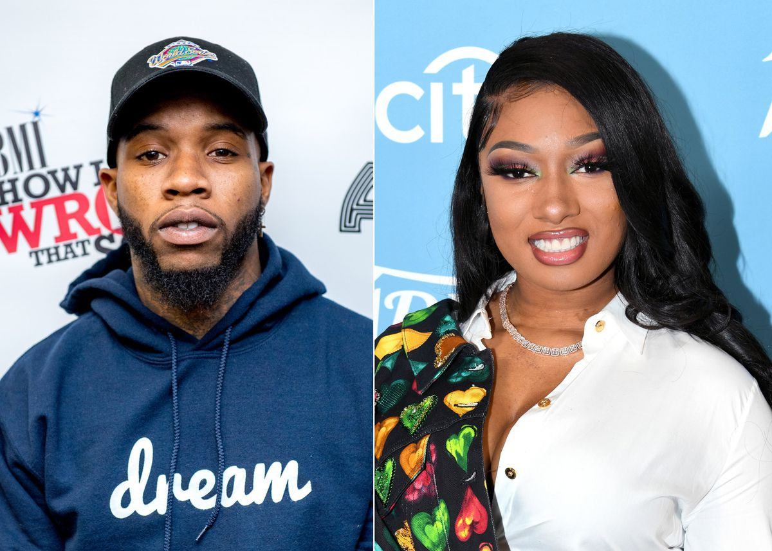
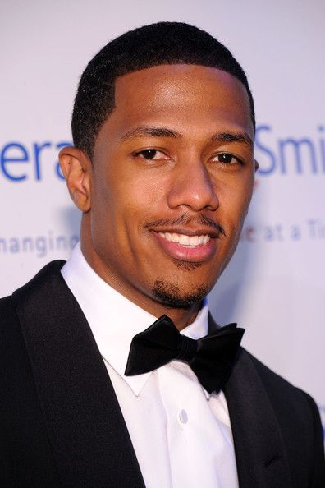
Social Media’s Role & Rehabilitation
Potential for rehabilitation (Australian Psychological Society)
We argue that the inclusion of a broader range of criminogenic needs, the design of specialist rehabilitation programs for rapists, or referral to existing specialist sexual or violent offender programs on the basis of individually assessed needs, are useful future directions. An urgent research priority is the publication of more treatment outcome studies for rapists, that include an analysis of both sexual and violent recidivism.
Cancel culture, social media/performative activism. Reputations
Other issues as well: what constitutes being cancelled. Is it something you can come back from? Where is the line of a point of no return?
“Lazy activists cancel people. Good activists change them” -The Tel Aviv Institute
Cancel culture
Rehabilitation and Learning
Eg. Tory Lanez, Nick Cannon

Slide 7
Hashtag activism
But on the other hand, there is almost this performative aspect of #metoo—not by the survivors necessarily, but mostly by these institutions and the public-at-large. It feels sometimes disingenuous. It’s almost like a, “See we fired him? It’s done. I don’t know what you are complaining about now.” - from Mia Mingus
#MeToo
#Sayhername
What happens when someone’s trauma becomes a hashtag?

Slide 8
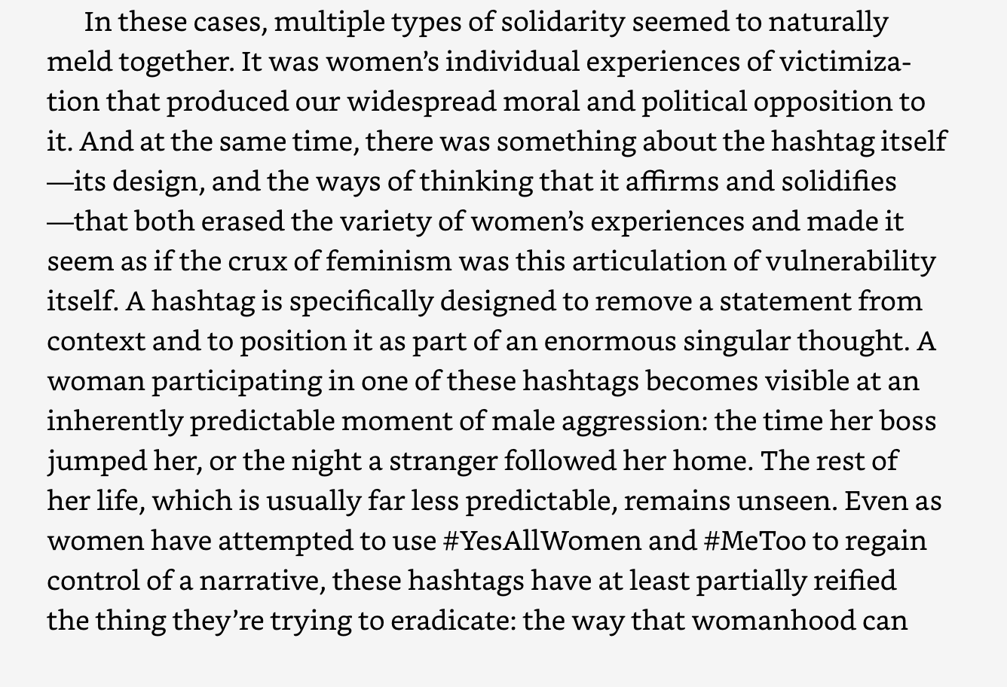
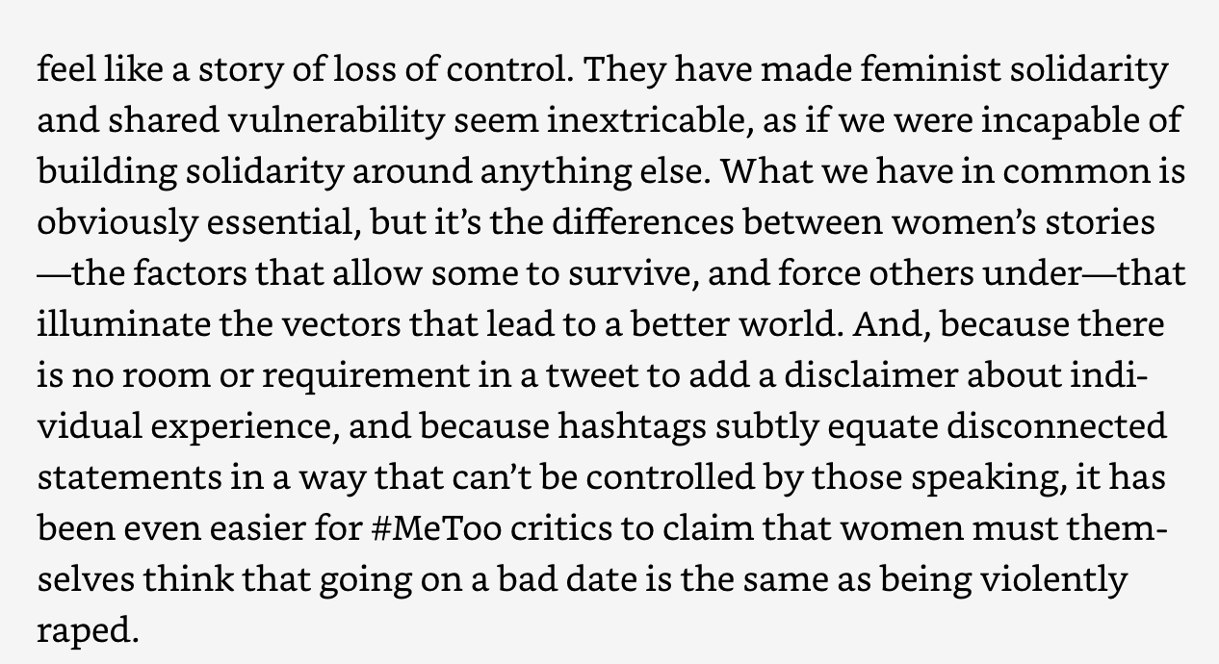
From “Trick Mirror” by Jia Tolentino [addresses the question posed in previous slide]

Slide 9
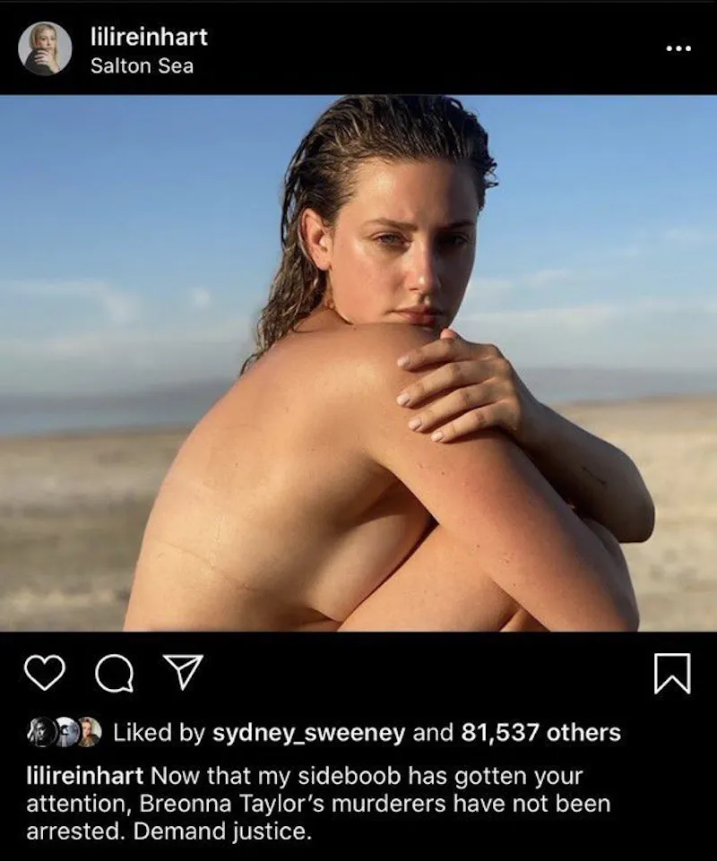
Celebrities play a tremendous role in strengthening the movement, but sometimes take it too far. In particular, it is important to draw attention to white women and how they extend the boundaries beyond they should.
There was a period of time when BLM, and later on other social movements, were the only main topics being posted on social media.
People were afraid that this would be the new normal.
So, the way this fear seemed to manifest itself was people posting pictures of themselves with captions about BLM or other ‘popular’ issues that were ‘in vogue.’

Slide 10
Thinking about the superficial protection of black women
Specifically, when thinking about Toyin, why was no one offering her shelter, support? She had to seek the support of a stranger when she had the social media, supposedly public, performative support of the community that she was tirelessly advocating for.
With the rise of mutual aid funds, we see black people asking for support
With some bail funds diverting donations, you can look for mutual aid funds, which fund grassroots efforts to provide resources, financial and otherwise, at the community level. The idea behind a mutual aid fund is that members prioritize the needs of the individuals of the community — such as rent, medical bills, cash bail — and allocate the donations to address the highest need first. Community members share their needs with each other and all contribute, either through money, material goods, or services. By donating to a mutual aid fund, you can pitch in to help communities dealing with structural violence and inadequate resources, which in turn can make communities more vulnerable to direct, or active, violence.

Slide 11
How do we sustain the support (so much in the first months, but what about now?)
How do we create a community of care?

